Slide 1

AI-Driven Flood Prediction And Mapping System

Slide 2

Introduction
Floods are among the most devastating natural disasters.
Traditional models rely on static data and often fail in dynamic conditions.
This research leverages AI to enhance flood prediction and mapping.

Slide 3

Problem Statement
Static models don’t capture non-linear flood dynamics.
Delayed warnings lead to massive economic and human losses.
A real-time, adaptive, and explainable system is urgently needed.

Slide 4
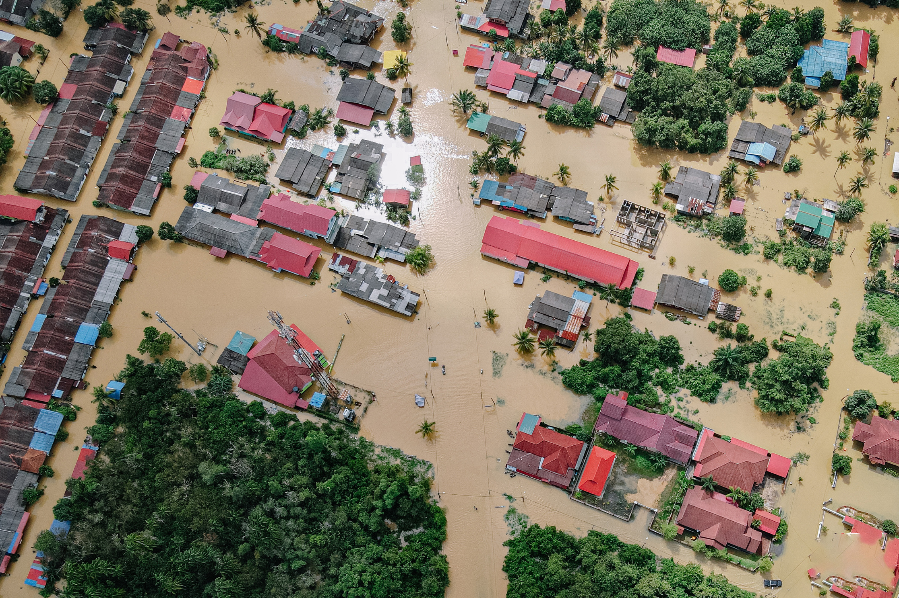
Proposed Solution
Use XGBoost and Random Forest for structured flood risk prediction.
Use U-Net deep learning for satellite image segmentation and flood mapping.
Deploy through an interactive Streamlit dashboard.
TRANSPIRATION

Slide 5
Research Aims & Objectives
Improve early warning systems using AI.
Objectives:
Develop ML models with structured data.
Implement U-Net for image-based mapping.
Integrate both in a unified dashboard.
Evaluate using metrics like Accuracy, F1, AUC-ROC, IoU.

Slide 6


Research Questions
How effectively can AI predict flood risk and map vulnerable areas?
How do ML models compare with traditional methods?
How accurate is U-Net in segmenting satellite images for floods?

Slide 7

Methodology
Data from Kaggle: hydrological parameters + satellite imagery
Data Preprocessing (balancing, normalization, augmentation).
Model Training (XGBoost, RF, U-Net).
Evaluation using cross-validation.
Deployment with Streamlit

Slide 8
ML MODELS FOR FLOOD RISK
Random Forest: Good for feature importance and interpretation.
XGBoost: Excellent accuracy and speed with imbalanced data.
Tuned via GridSearchCV.

Slide 9

U-Net Architecture:
Encoder-decoder with skip connections.
Preprocessing:
Resizing, normalization, binarization.
Augmented with Albumentations.
Trained with custom BCE + Dice loss.
Deep Learning for Flood Mapping

Slide 10


System Architecture
Data Pipeline → ML/DL Models → Evaluation → Streamlit App
GUI Features:
Risk Prediction- input sliders.
Image Upload → Segmented Map Output.
Real-time visual feedback.

Slide 11

Results: ML Models
XGBoost
Accuracy: 99.21%
AUC: 0.9998 (near-perfect)
Log Loss: 0.0213 → excellent probability calibration
Strengths: Great at predicting Medium Risk; well-calibrated confidence levels.
Random Forest
Accuracy: 99.1%
AUC: 0.99
Log Loss: 0.077 → slightly higher than XGB
Strengths: Robust baseline performance; interpretable decision trees.
ROC and Precision-Recall Curves showed high class separability
Both models achieved >0.98 Precision for High and Medium flood risk.
XGBoost had smoother ROC & PR curves, indicating better stability.
Confusion Matrices showed minimal misclassification, with XGBoost being slightly more precise in Medium Risk.
.

Slide 12

RESULTS: U-NET
IoU: ~0.88 | Dice Coefficient: ~0.90
Fine-tuned for better boundary segmentation.
Visual outputs aligned well with ground-truth flood maps.

Slide 13
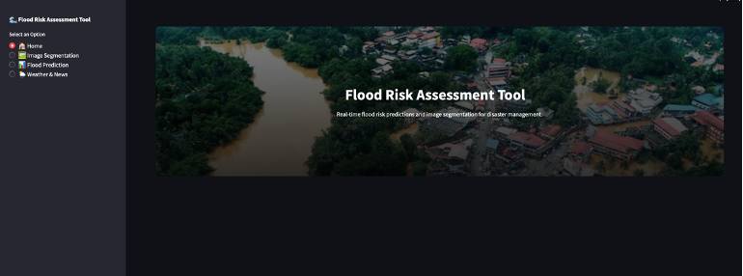

Home
Main Functionalities:
🌧️ Flood Risk Prediction (Random Forest & XGBoost)
Inputs: Sliders for rainfall, infrastructure, climate, etc.
Output: Low / Medium / High risk
🛰️ Flood Image Segmentation
Upload satellite images
Get visual map showing flooded areas
User-friendly design with real-time feedback.

Slide 14

Limitation &Future Research
Challenges Faced:
Data imbalance: Few high/low flood probability cases → solved via oversampling & synthetic data.
Large image size & varied dimensions → resolved by standardizing to 256x256 and normalizing.
Training DL models with limited compute → used data generators, callbacks, and fine-tuning.
Future work
Limited data regions.
Need for real-time satellite image integration.
Future:
Integrate more diverse data sources.
Expand to real-time weather APIs.

Slide 15





Analysis and Conclusion
AI significantly improves flood prediction and mapping.
ML and DL models outperform traditional methods.
XGBoost and Random Forest showed high accuracy in predicting flood risk based on structured data.
The U-Net model effectively segmented satellite images to identify flood-affected areas with high spatial accuracy.
System ready for real-world deployment to support disaster resilience.

Slide 16


Thank you!
Do you have any questions?

